Slide 1
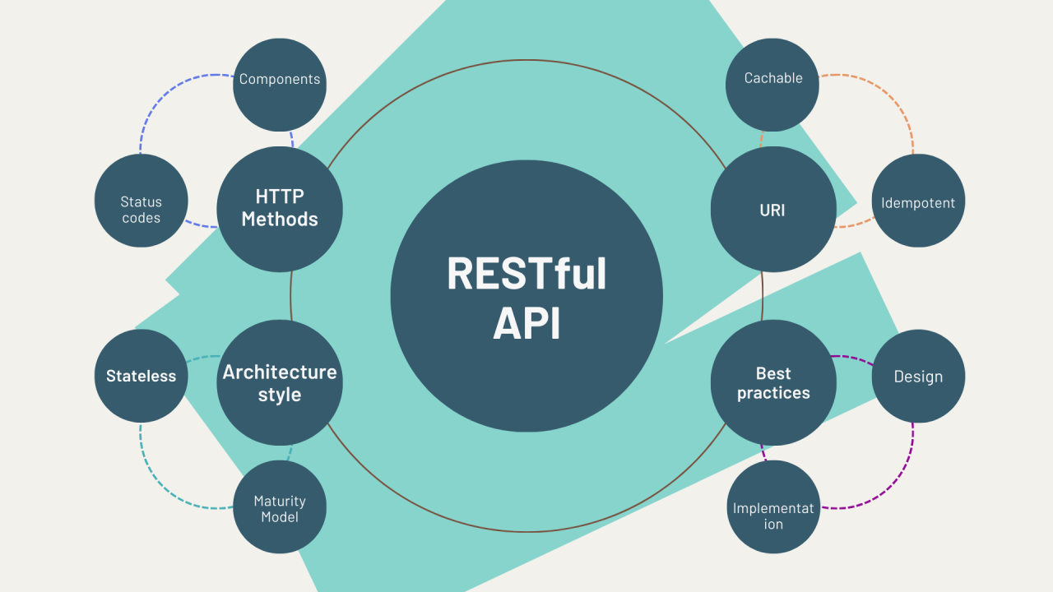
Representational State Transfer

Slide 2
Principles of REST Architecture
Statelessness: RESTful APIs are stateless, meaning each request from a client contains all the information needed to process that request.
Uniform Interface: APIs have a uniform interface with standard HTTP methods (GET, POST, PUT, DELETE) for CRUD operations.
Resource-Based: Resources are identified by URIs (Uniform Resource Identifiers) and manipulated through representations (JSON, XML, etc.).
Self-Descriptive Messages: Responses include metadata (headers, status codes) to describe how to process the message.
Hypermedia as the Engine of Application State (HATEOAS): APIs provide links and navigation controls in responses to guide client interactions.

Slide 3
HTTP Methods in RESTful APIs
GET: Retrieve resource representations.
POST: Create new resources.
PUT: Update existing resources.
DELETE: Remove resources.
Other Methods: OPTIONS, HEAD, PATCH, etc., for specific use cases

Slide 4
Designing RESTful Endpoints
Resource Naming: Use nouns for resources (e.g., /users, /products) for clear and meaningful endpoint naming.
URL Structure: Follow a hierarchical structure for nested resources (e.g., /users/{userId}/posts).
Versioning: Implement versioning in APIs (e.g., /v1/users) to manage changes and ensure backward compatibility.
Query Parameters: Use query parameters for filtering, sorting, pagination, and other query options (e.g., /users?limit=10&page=1).

Slide 5
Handling Authentication and Authorization
Authentication: Implement authentication mechanisms (Basic Auth, OAuth, JWT) to verify client identities and secure API access.
Authorization: Enforce access control policies to restrict API access based on user roles, permissions, and scopes.

Slide 6
CRUD Operations in RESTful APIs
Create (POST): Create new resources (e.g., /users - POST data to create a new user)
Read (GET): Retrieve resource representations (e.g., /users/{userId} - GET user details).
Update (PUT/PATCH): Update existing resources (e.g., /users/{userId} - PUT data to update user details).
Delete (DELETE): Remove resources (e.g., /users/{userId} - DELETE user).

Slide 7
Best Practices for RESTful APIs
Use HTTP Status Codes: Use appropriate HTTP status codes (200, 201, 400, 401, 404, etc.) to indicate the status of API requests and responses.
Error Handling: Provide meaningful error messages and use consistent error formats for easy troubleshooting
Documentation: Document API endpoints, request formats, response formats, and error codes for developers
Versioning Strategies: Choose versioning strategies (URI versioning, header versioning) to manage API changes.

Slide 8
Testing and Debugging RESTful APIs
Unit Testing: Test individual API endpoints and functionalities using unit tests
Integration Testing: Test API integrations with other services or systems
Automated Testing: Use tools like Postman, Newman, or REST Assured for automated API testing
Debugging: Debug API issues using logging, monitoring, and debugging tools

Slide 9
Real-world Examples of RESTful APIs
Popular APIs: Showcase examples of popular RESTful APIs (e.g., GitHub API, Twitter API, Google Maps API)
Use Cases: Explore real-world use cases of RESTful APIs in various industries (e-commerce, social media, finance, etc.)
Benefits: Discuss the benefits of RESTful APIs in terms of scalability, performance, and developer adoption

Slide 10
Future Trends in RESTful APIs
Microservices Architecture: Integration of RESTful APIs in microservices-based architectures for agility and scalability
Hypermedia APIs: Adoption of hypermedia-driven APIs (HATEOAS) for better discoverability and navigation
API Management: Integration with API management platforms for API governance, monitoring, and analytics
Serverless Computing: Use of RESTful APIs in serverless computing environments for event-driven applications

